Slide 1





My Journey
Vishal Kannan
2020 – Integrated Master’s in Bioengineering and Medical Nanotechnology
Experience: Biomedical instrumentation, signal processing, tissue engineering and 3D printing
Neurobiology and cognitive sciences, Physiological control systems
Why do we behave in a certain way??
Present – Master’s in Integrative Neuroscience
- Systems, behaviour and theoretical neuroscience
Present – Research Assistant/ Master thesis student in CortXplorer group, Leibniz Institute for Neurobiology, Magdeburg, Germany
Neural computation and behaviour
Notes:
Start with who you are and why you are here!
-- Recent masters graduate looking for PhD options, met Daniela at imbizo and got super interested in her work. A bit about my background,

Slide 2

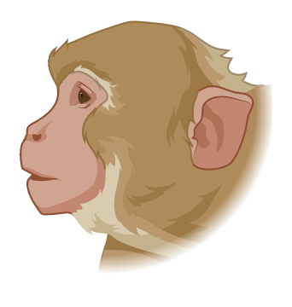
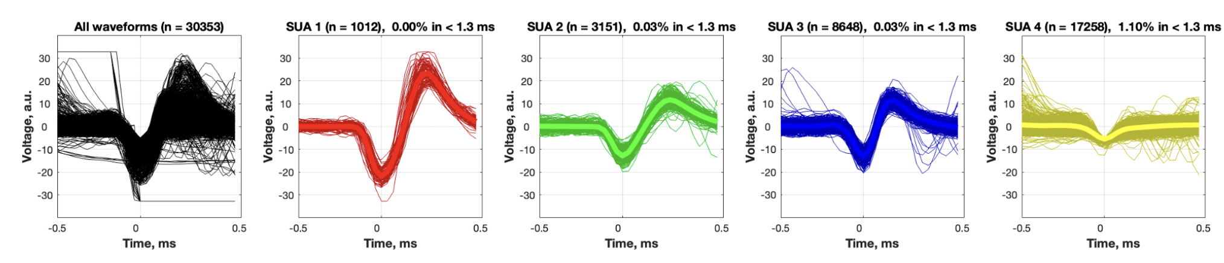


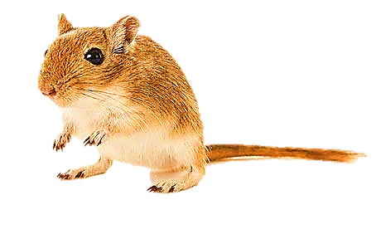
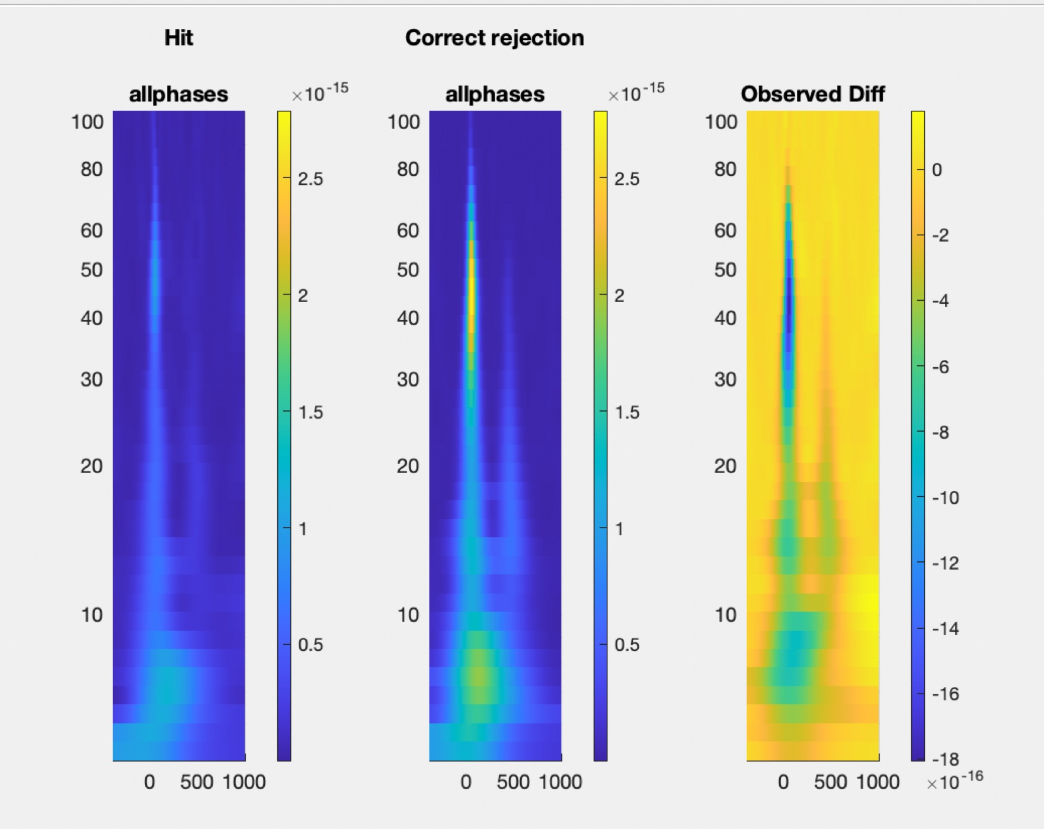
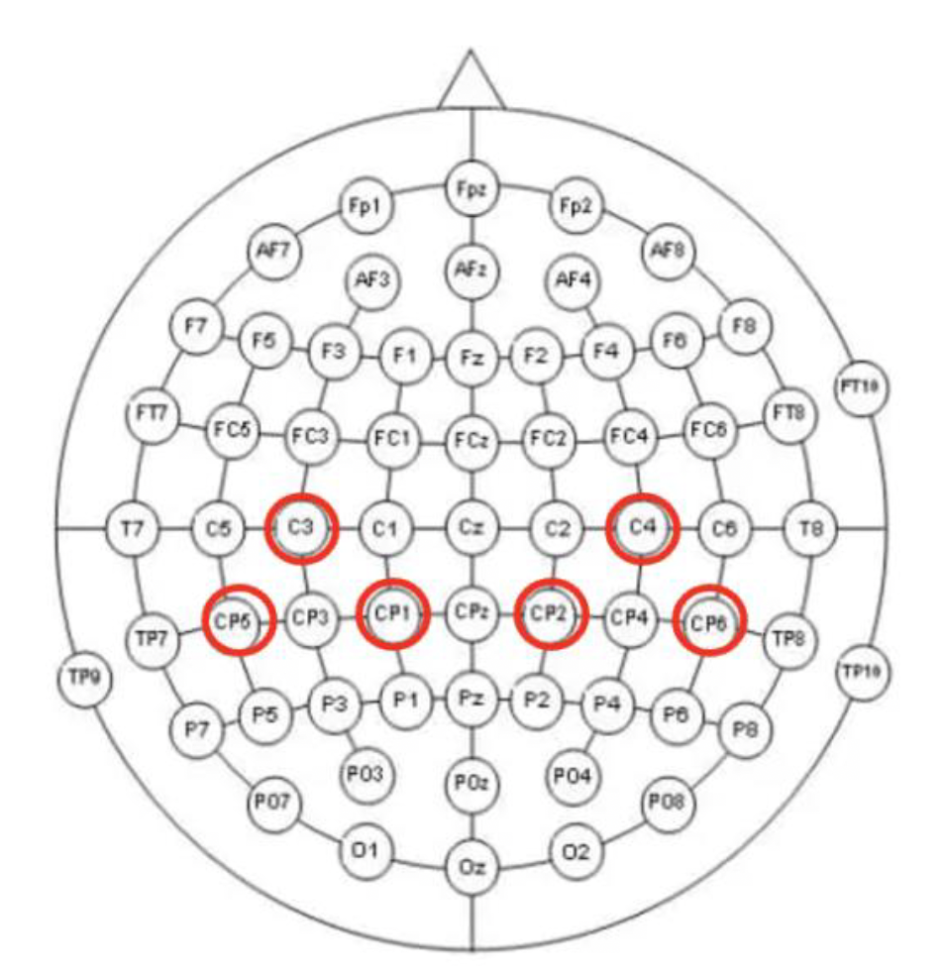


Research experience
Offline spike sorting
How does altering single-cell and population-level activity affect a monkey’s working memory?
Learning and memory
Spatial audio setup with a software interface
Sensory perception
How does sound localization help in perceiving spatial audio?
How does sensory integration in a Gerbil’s auditory cortex guide an animal’s decision in a changing environment? (Auditory reversal learning)
Linear array of speakers
Cognitive flexibility
Time frequency analysis
Supervised learning – movement intention and movement
Clinical rehabilitation
Potential classification feature to design a brain-computer interface for post-stroke rehabilitation
Adaptive decision making
How do neuronal activity patterns in the frontal cortex shape an animal’s adaptive decision-making behaviour in a foraging task?
Current work (Master thesis)

Slide 3
Research experience
Offline spike sorting
How does altering single-cell and population-level activity affect a monkey’s working memory?
Learning and memory
Spatial audio setup with a software interface
Sensory perception
How does sound localization help in perceiving spatial audio?
Linear array of speakers
How does sensory integration in a Gerbil’s auditory cortex guide an animal’s decision in a changing environment? (Auditory reversal learning)
Cognitive flexibility
Time frequency analysis
Adaptive decision making
How do neuronal activity patterns in the frontal cortex shape an animal’s adaptive decision-making behaviour in a foraging task?
Current work (Master thesis)

Slide 4


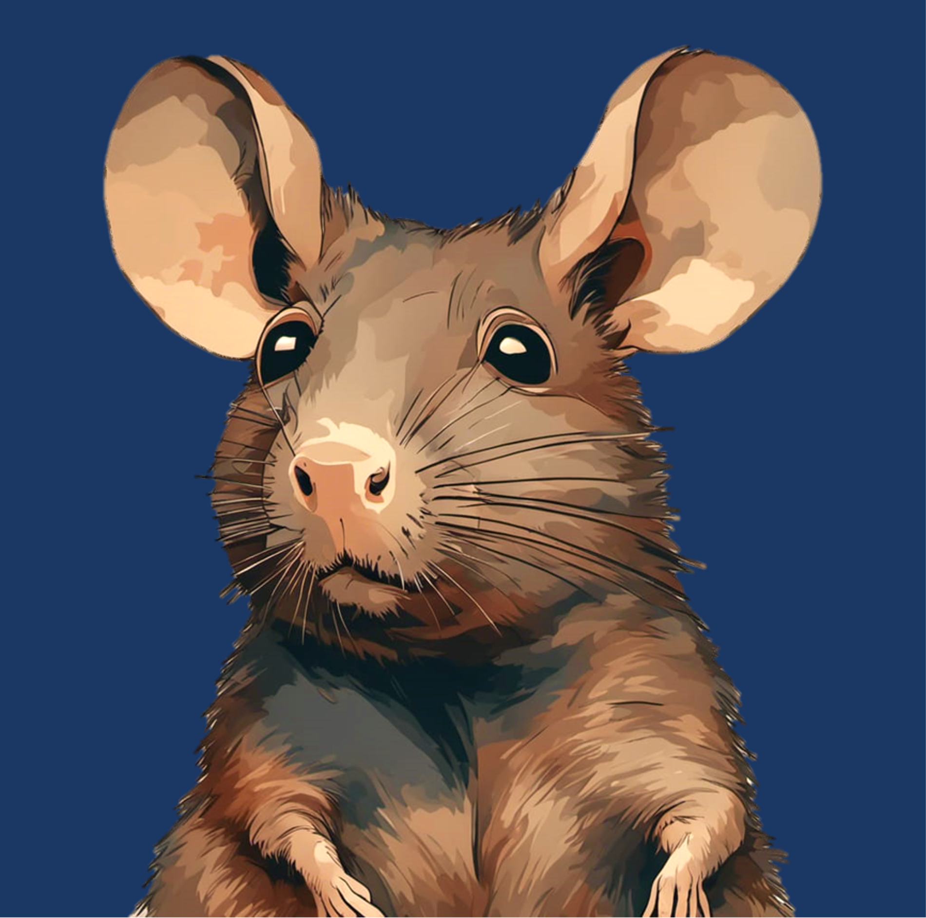

Navigating Uncertainty: Neural Mechanisms of Probabilistic Foraging in Mongolian Gerbils
Supervisor: Prof. Dr. Max Happel

Slide 5
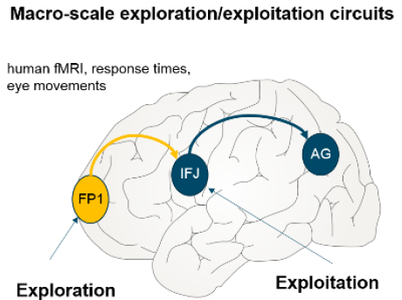
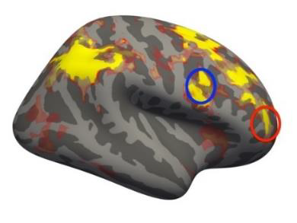
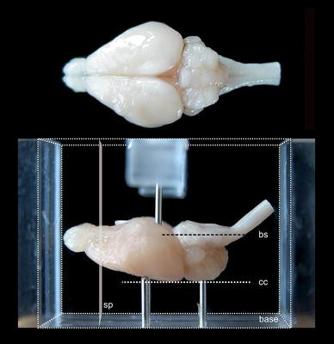

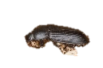



Decision making in uncertain situations
Exploration-exploitation dilemma
Neural substrates for exploratory behaviour
Frontopolar cortex in humans – Gambling studies (Daw et al., 2006 ) (Raja Beharelle et al., 2015)
aPFC in Monkeys (Mansouri et al., 2015)
Our Study
Rodent model – Mongolian gerbils (Desert rodents)
The Situation
Radtke-Schuller et al., 2016
Frontal region A (FrA) – analogous to Frontopolar cortex in humans
Exploitation
Exploration
(Shuai and Song, 2011)
Notes:
We often must choose whether to try something new (exploration) or stick with a proven strategy (exploitation). Balancing this trade-off is important for survival and growth across species because, without exploration, we would perseverate with the same strategies and never discover better options. Which brain mechanisms are responsible for our ability to make these decisions?
Humans are remarkably curious, and that is useful in helping us to learn about new environments and possibilities. But curiosity killed the cat, they say, and it also carries with it substantial potential risks and costs for us. Statisticians, engineers and economists have long considered ways of balancing the costs and benefits of exploration.

Slide 6
Objective
Neuronal circuit functions in frontal cortex – exploitative vs explorative strategies
frontal activity before patch leaving decision
Layer-dependent processing

Slide 7
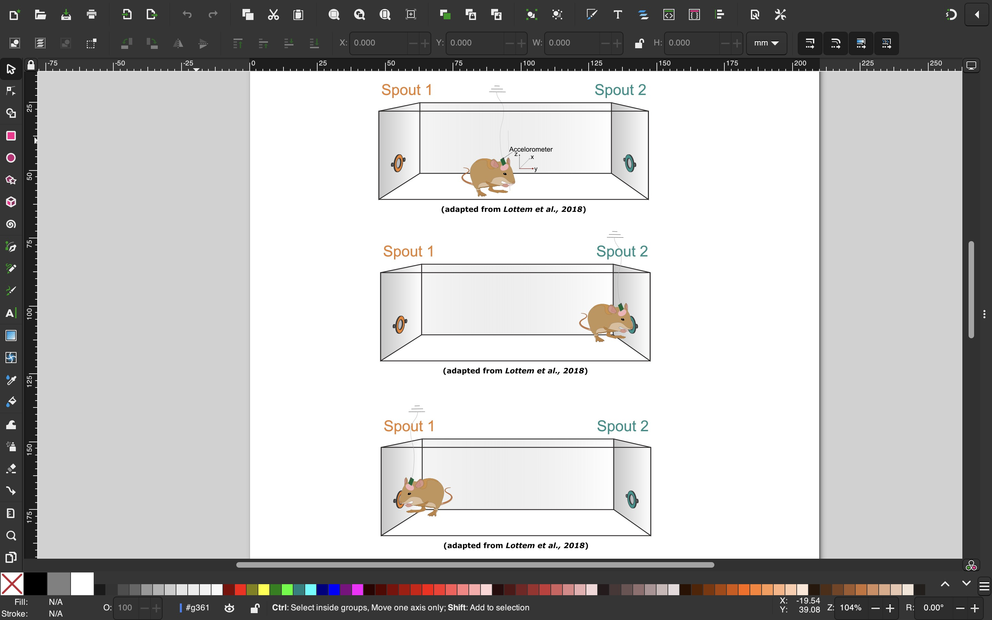
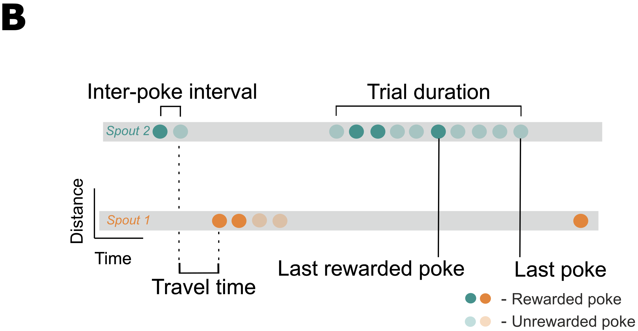
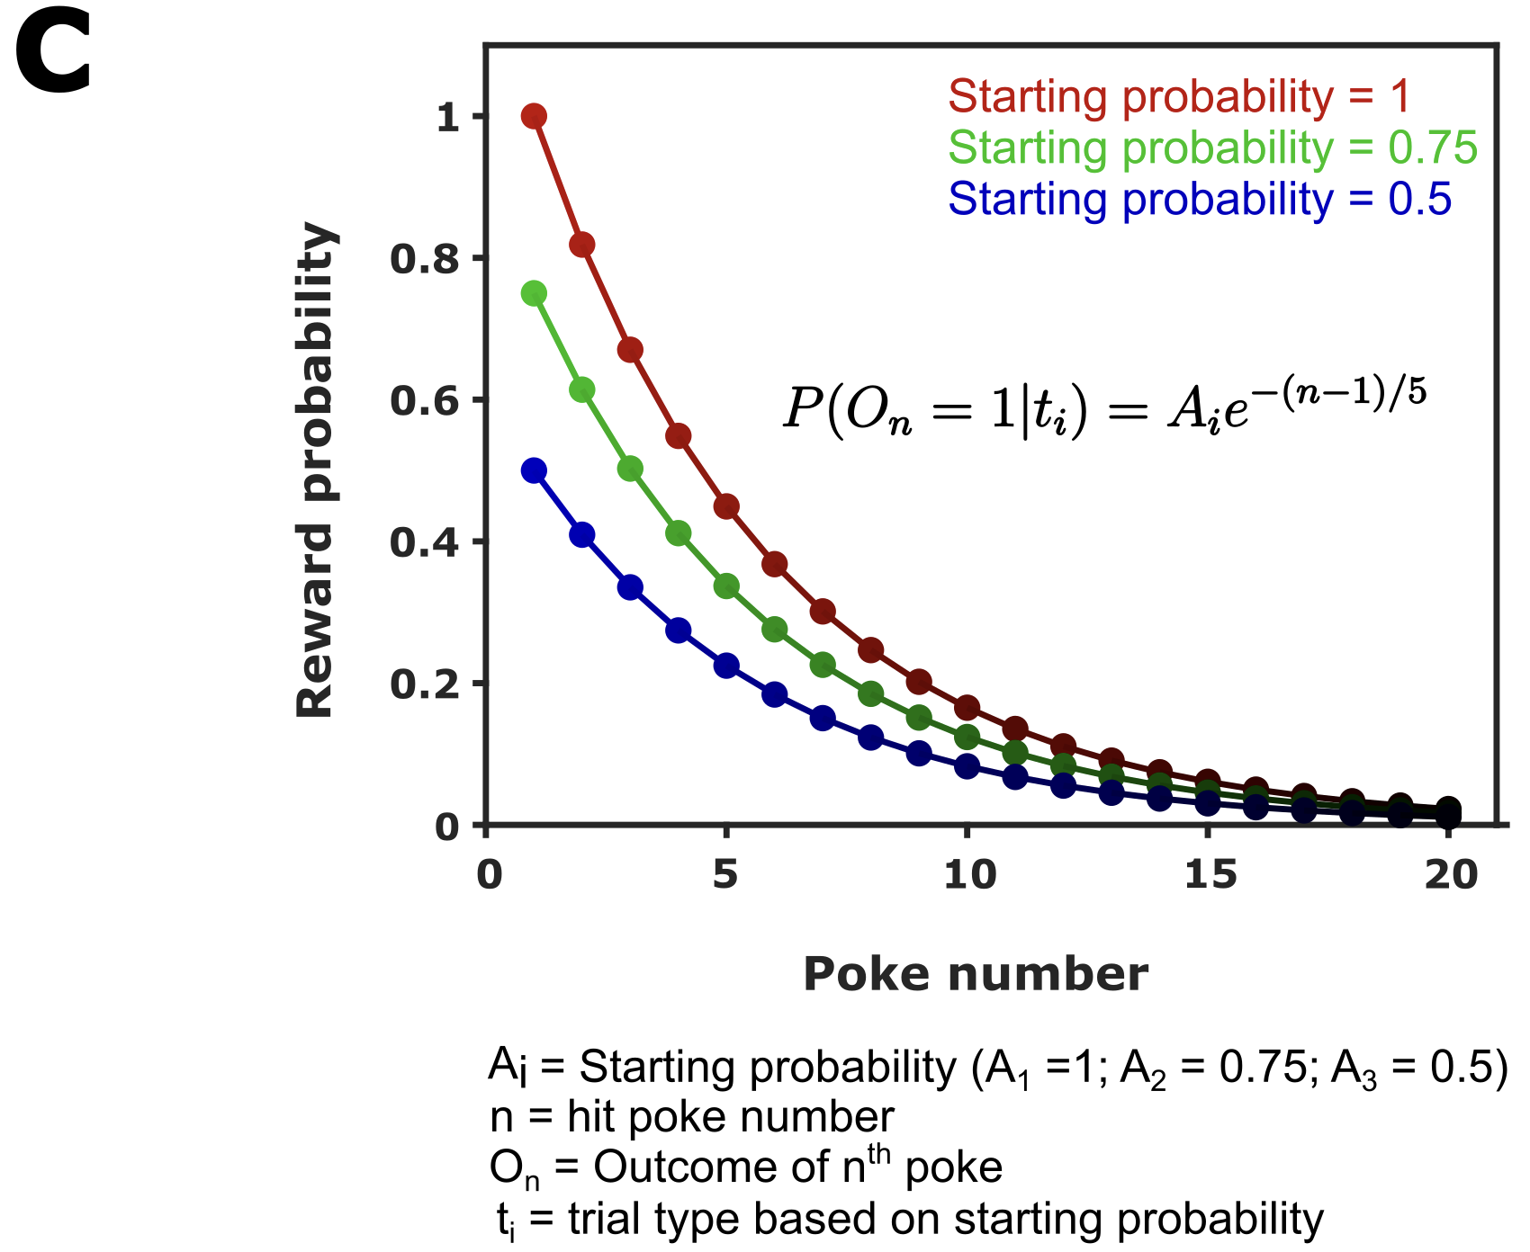

The probabilistic foraging task
1. Exponential decay of reward probability
2. Dynamic starting reward probability
?

Slide 8
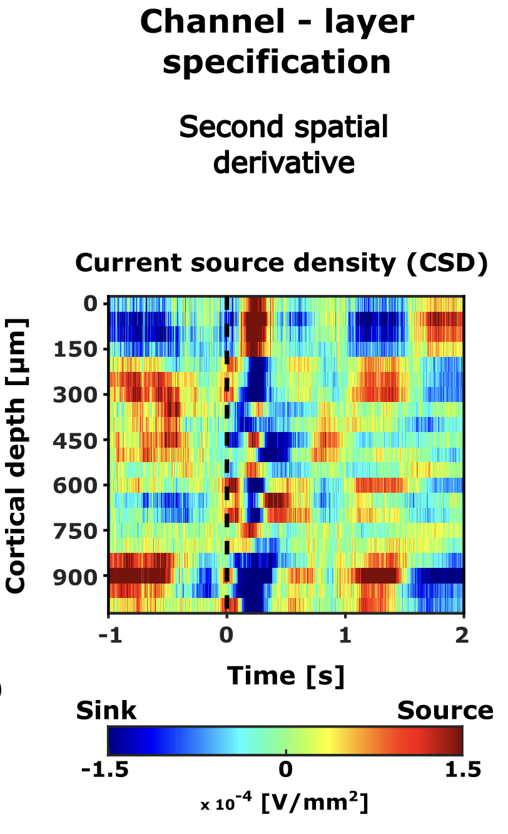
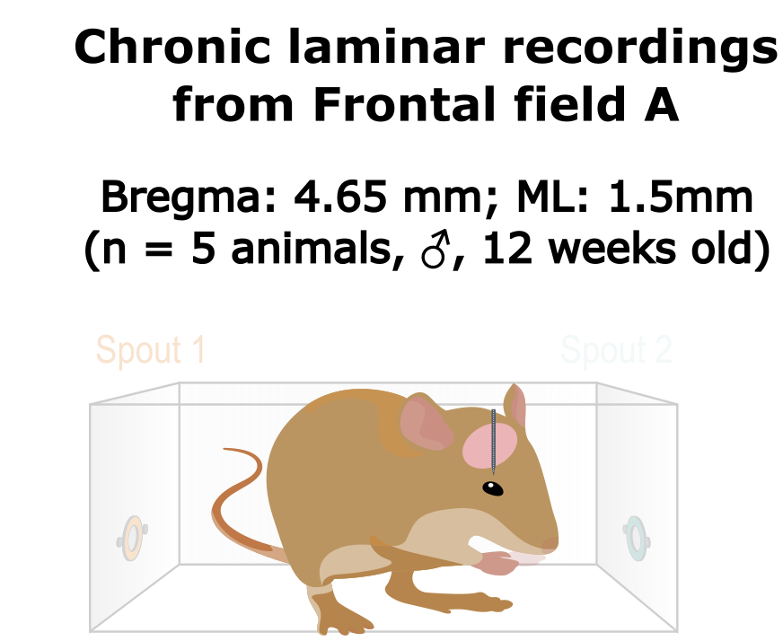
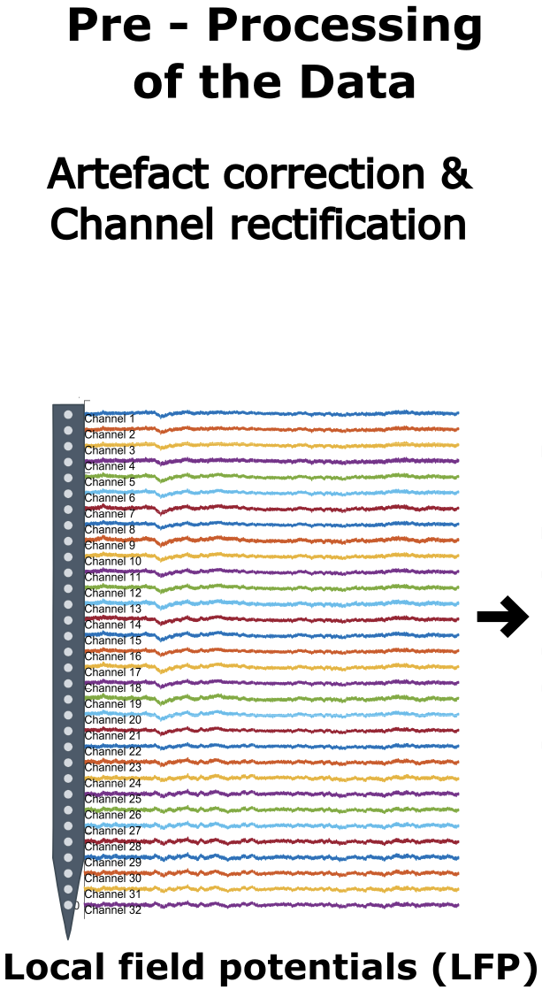
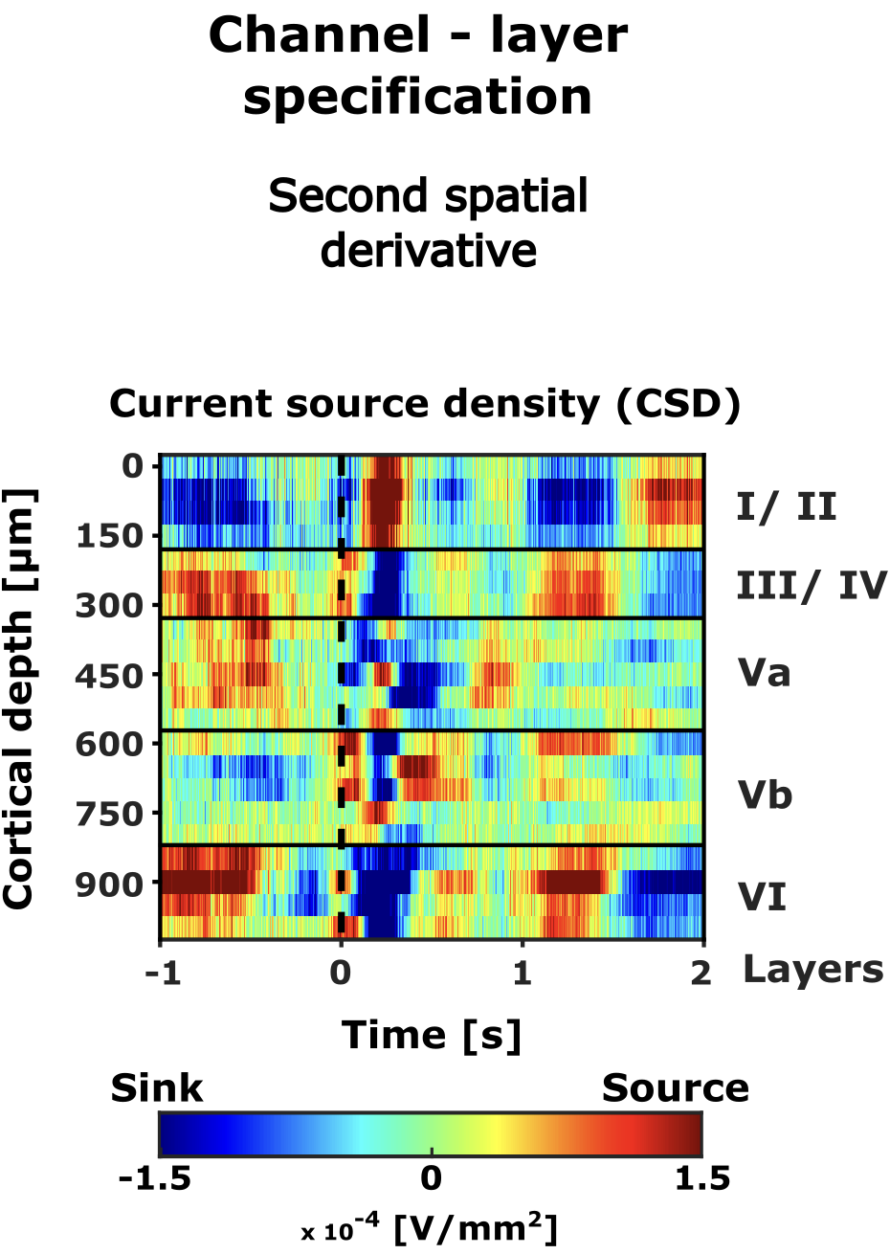
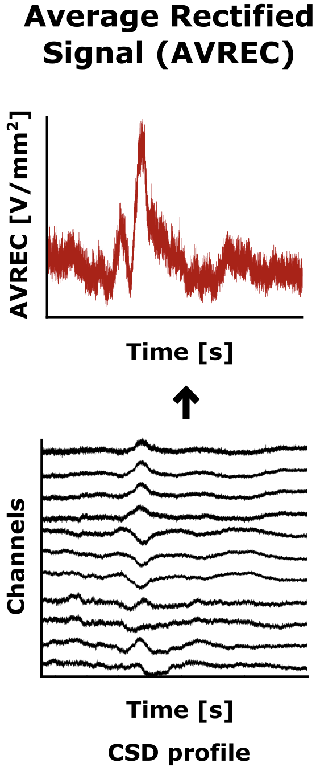

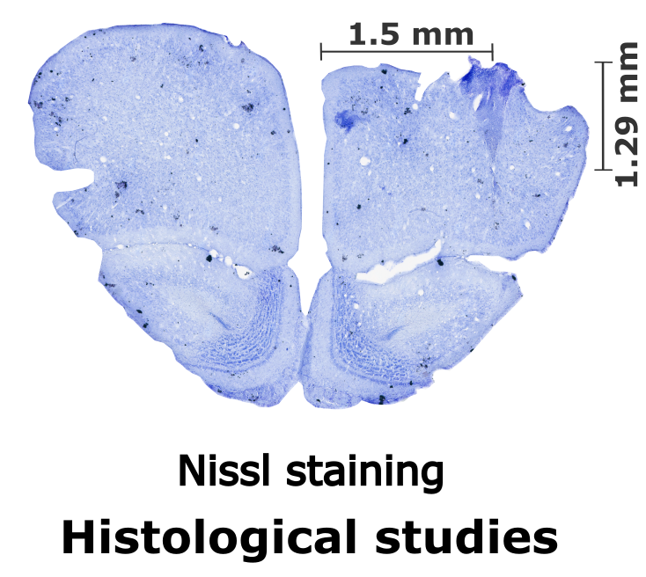
How do we study this?
Overall frontal activity
Average across layers

Slide 9
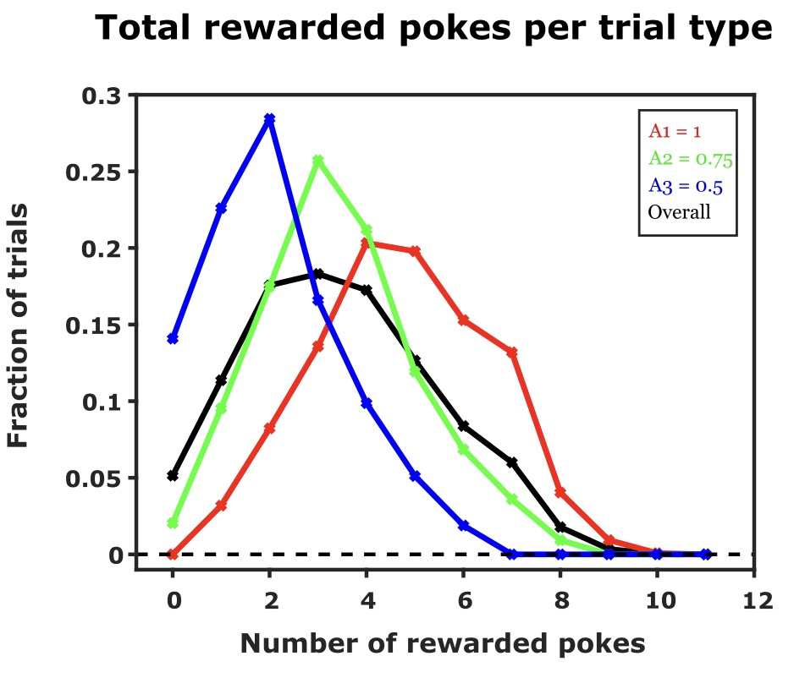
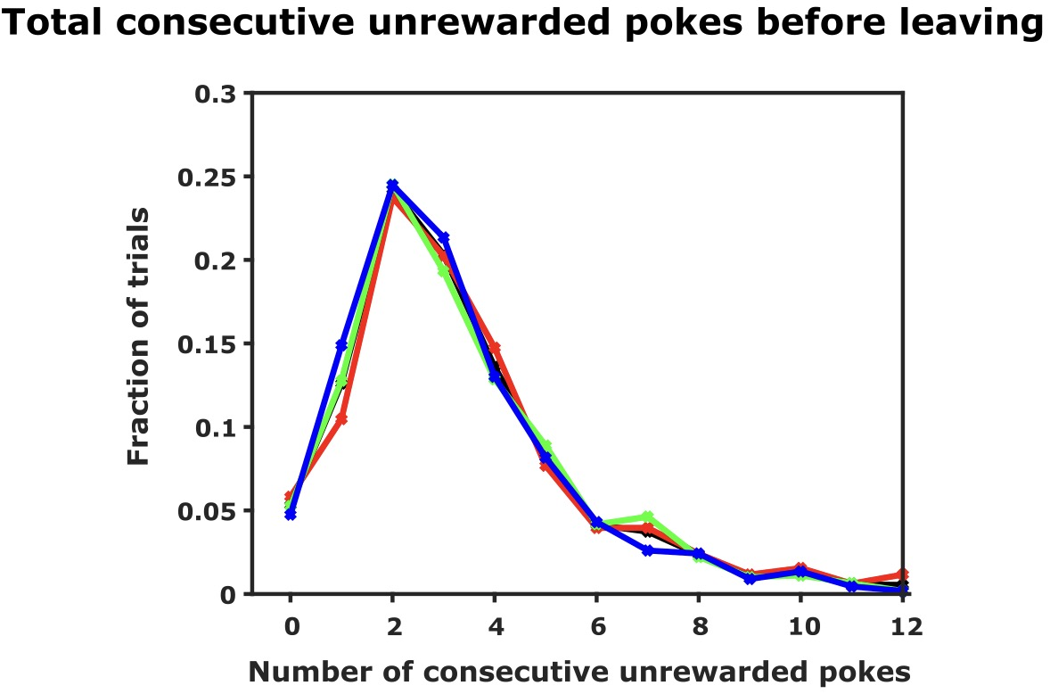

Animals make inference-based decision
The spout leaving behaviour
Total consecutive unrewarded pokes before leaving
When is the right time to explore?
Starting probability
Rewards in a trial
Number of consecutive unrewarded pokes before leaving
$$∝$$
Starting reward probability
# Total rewards received in a trial
Independent
Infer the hidden structures – value reward and no reward differently

Slide 10
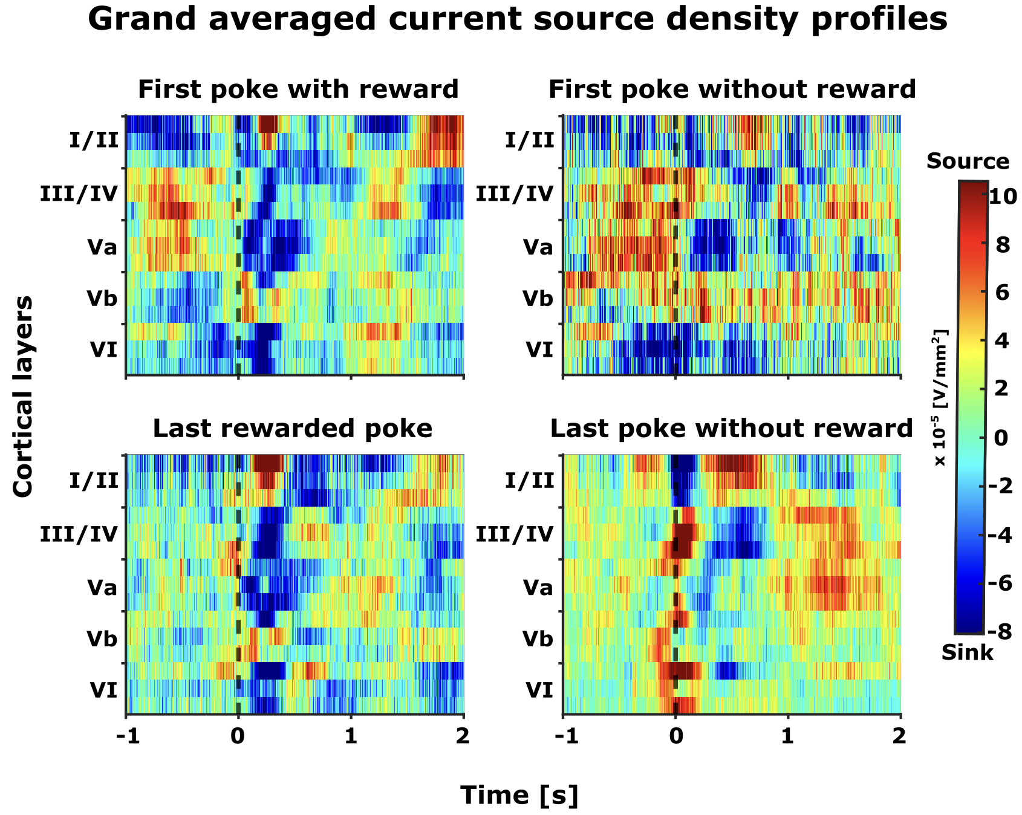
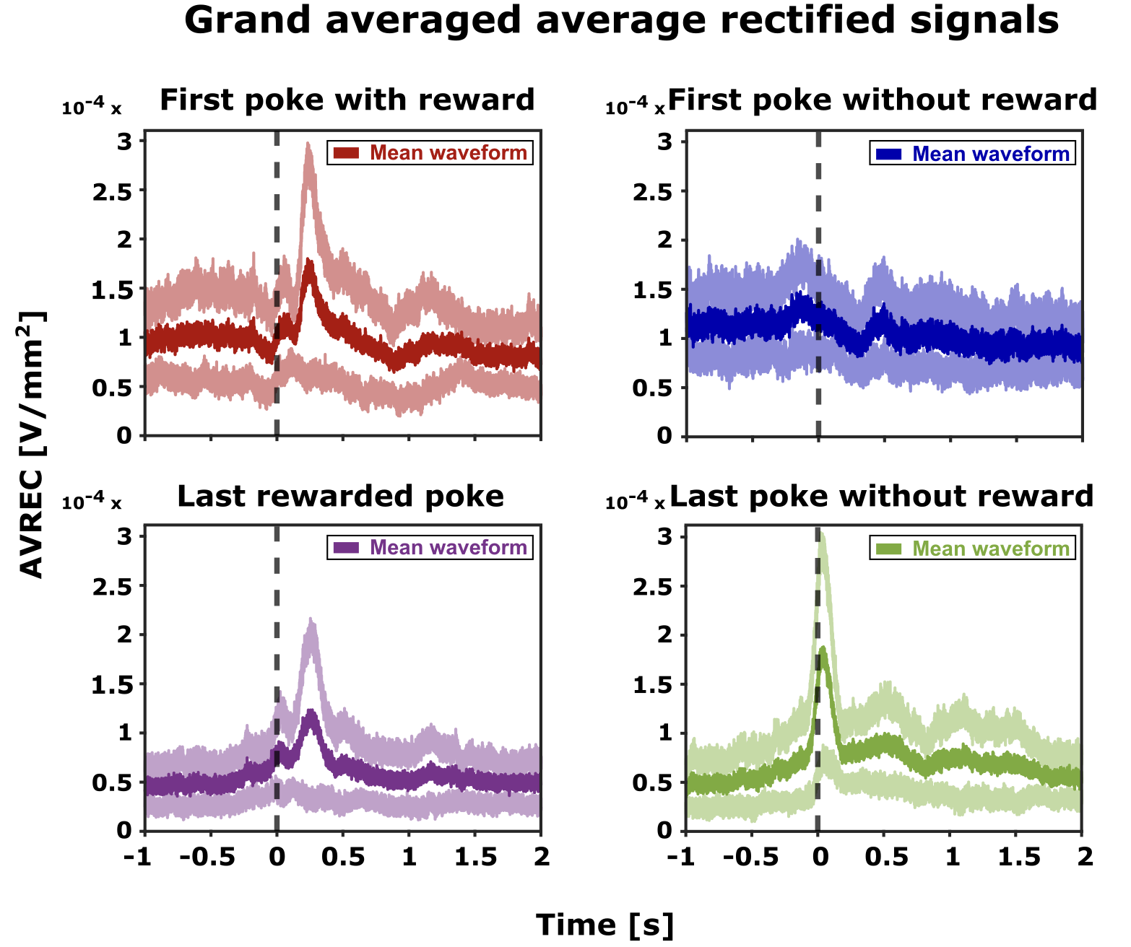
Distinct motor and reward related frontal activity

Slide 11
FrA encodes expectation and evaluation of reward
Current source density analysis
Epochs of interest
Rewarded
Unrewarded
First poke
First poke
Last rewarded poke
Last poke
Average across layers
Overall frontal activity
Does the Frontal region A (FrA) represent animal’s behaviour?
Frontal activity
Distinct spatiotemporal profile

Slide 12
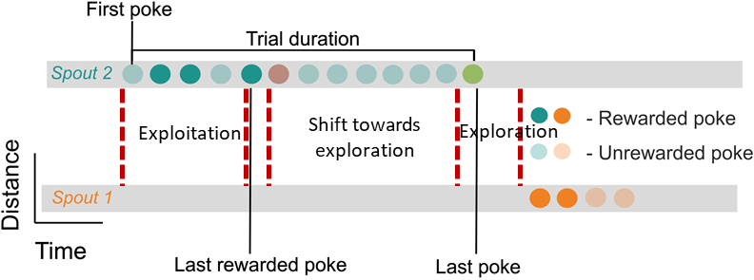
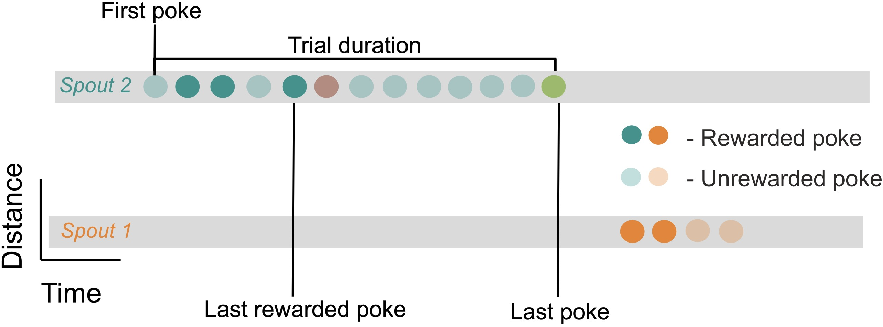
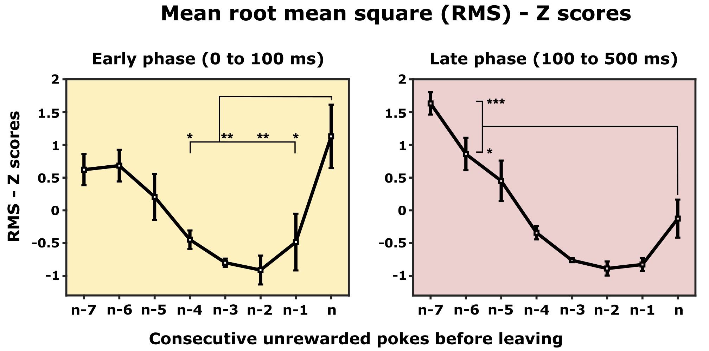
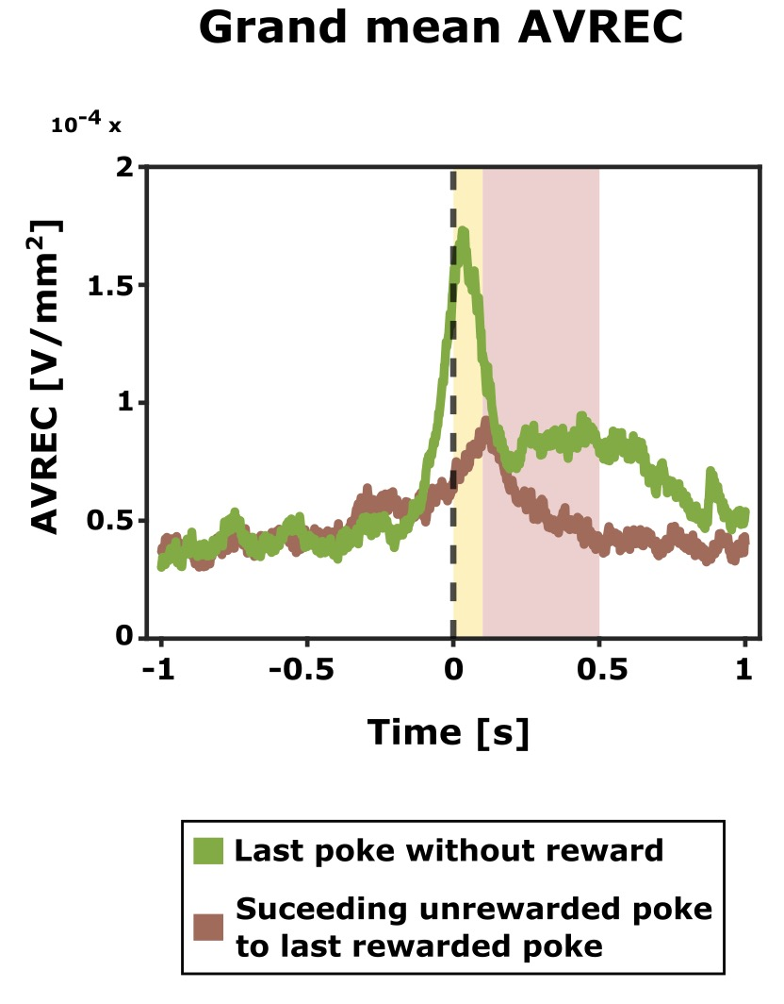
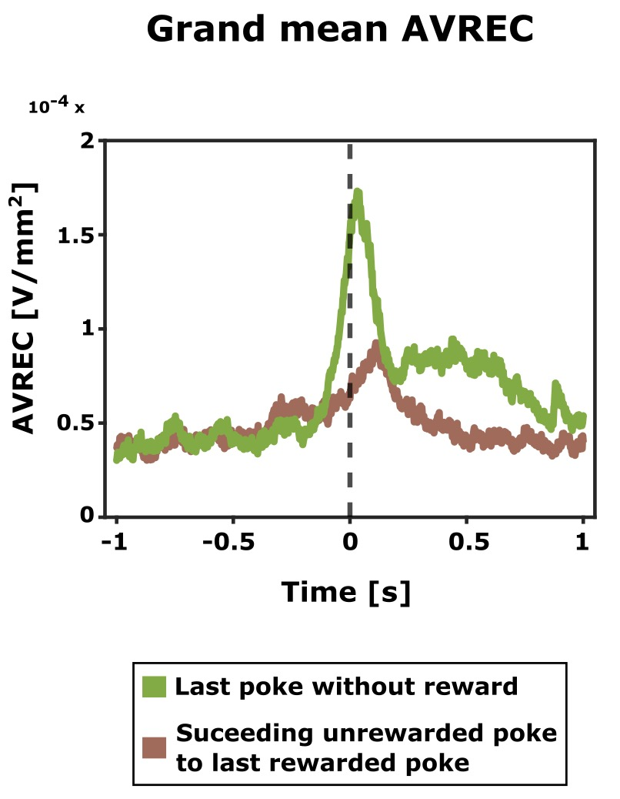

Shifts in frontal activity patterns: Exploitation to exploration
What makes the last poke the last one?
Shift towards exploration
Exploration
Exploitation
Alteration of expectations over time
Individual poke RMS
Early phase – 0 to 100 ms after the end of the poke
Late phase – 100- 500 ms after the end of the poke

Slide 13
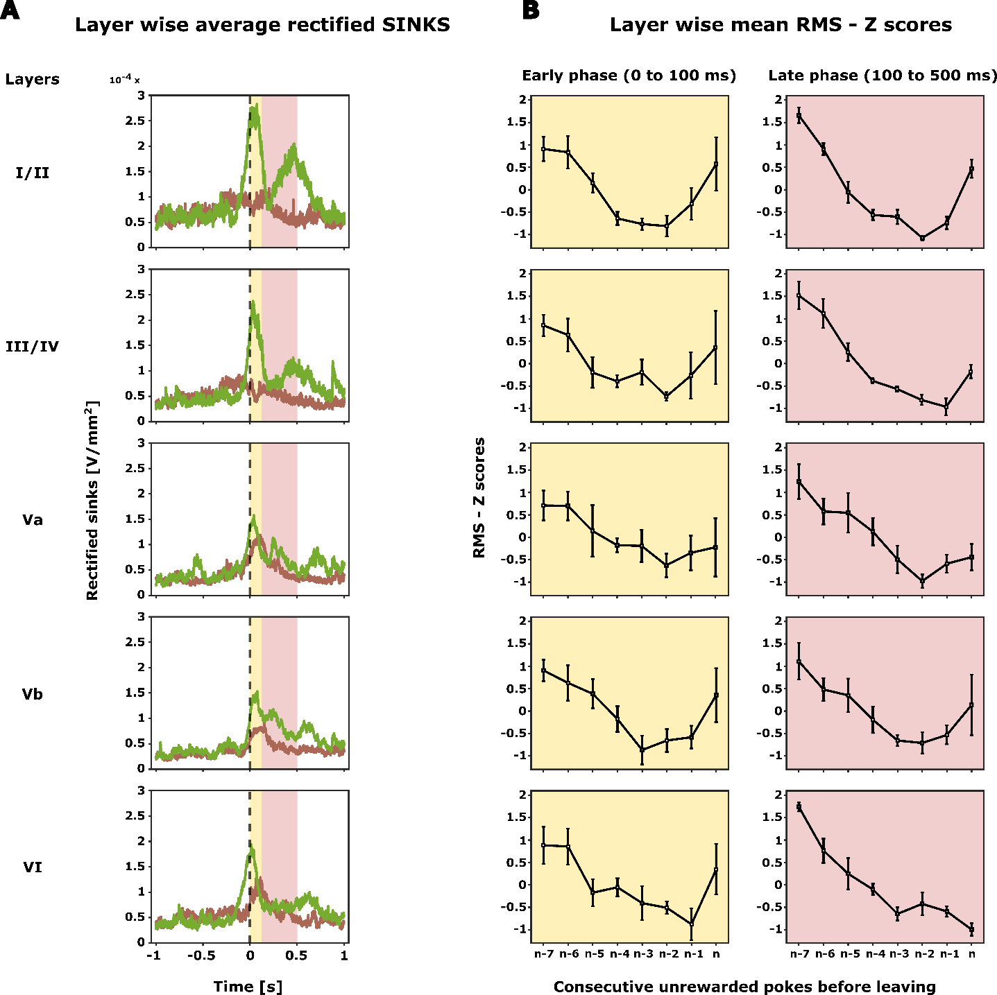

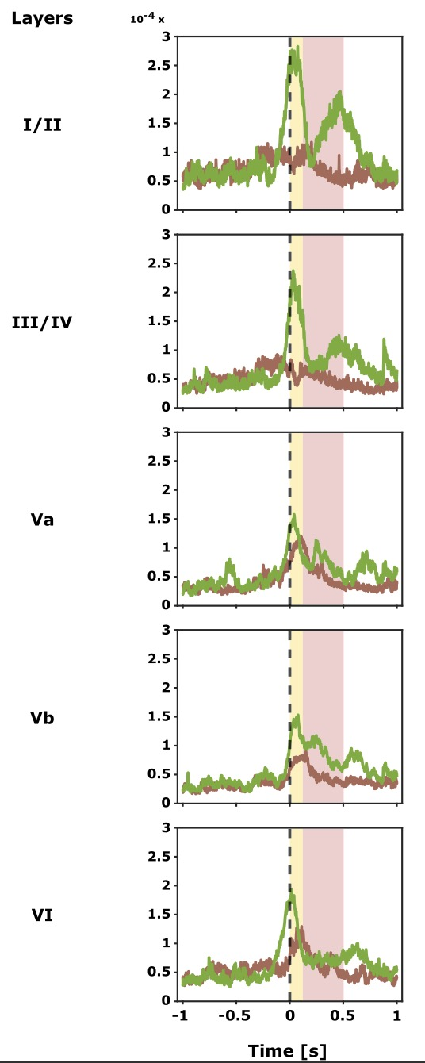
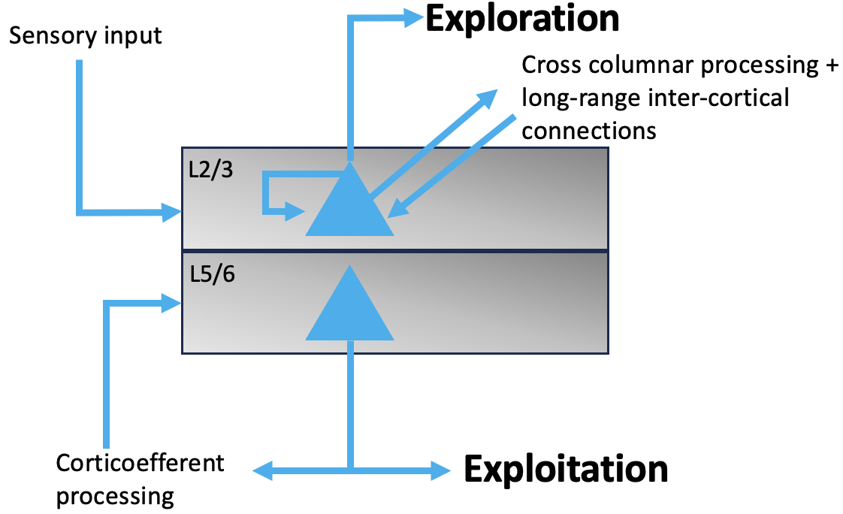
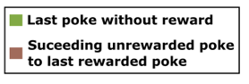
Shifts in layer specific activity patterns: Exploitation to exploration
Overall frontal activity
Individual poke RMS
1. Shift from deeper to upper layers
Early phase – 0 to 100 ms after the end of the poke
Late phase – 100- 500 ms after the end of the poke
2. During the phase of switching from exploitation to exploration, initially, activity decreases in all cortical layers.
3. At the beginning of exploration, the activity in layer I/II and III/IV increases in the early phase.
(Douglas and Martin, 2007; Godlove et al., 2014)

Slide 14
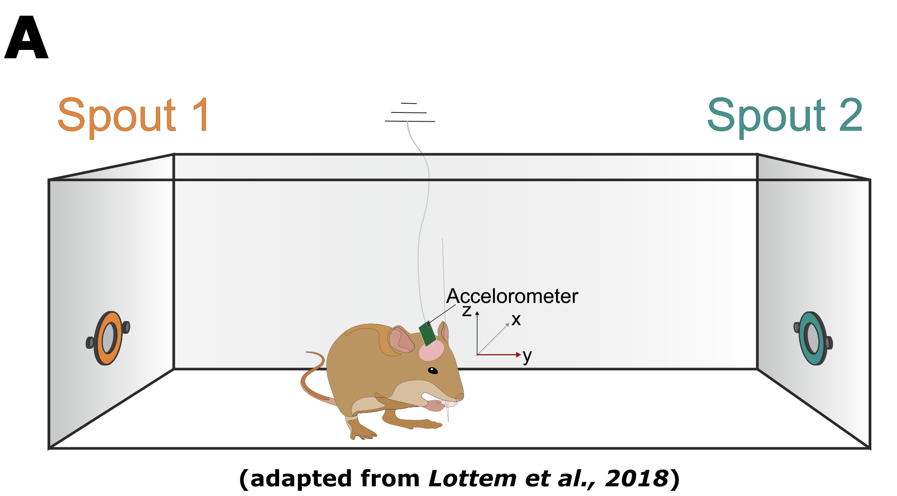
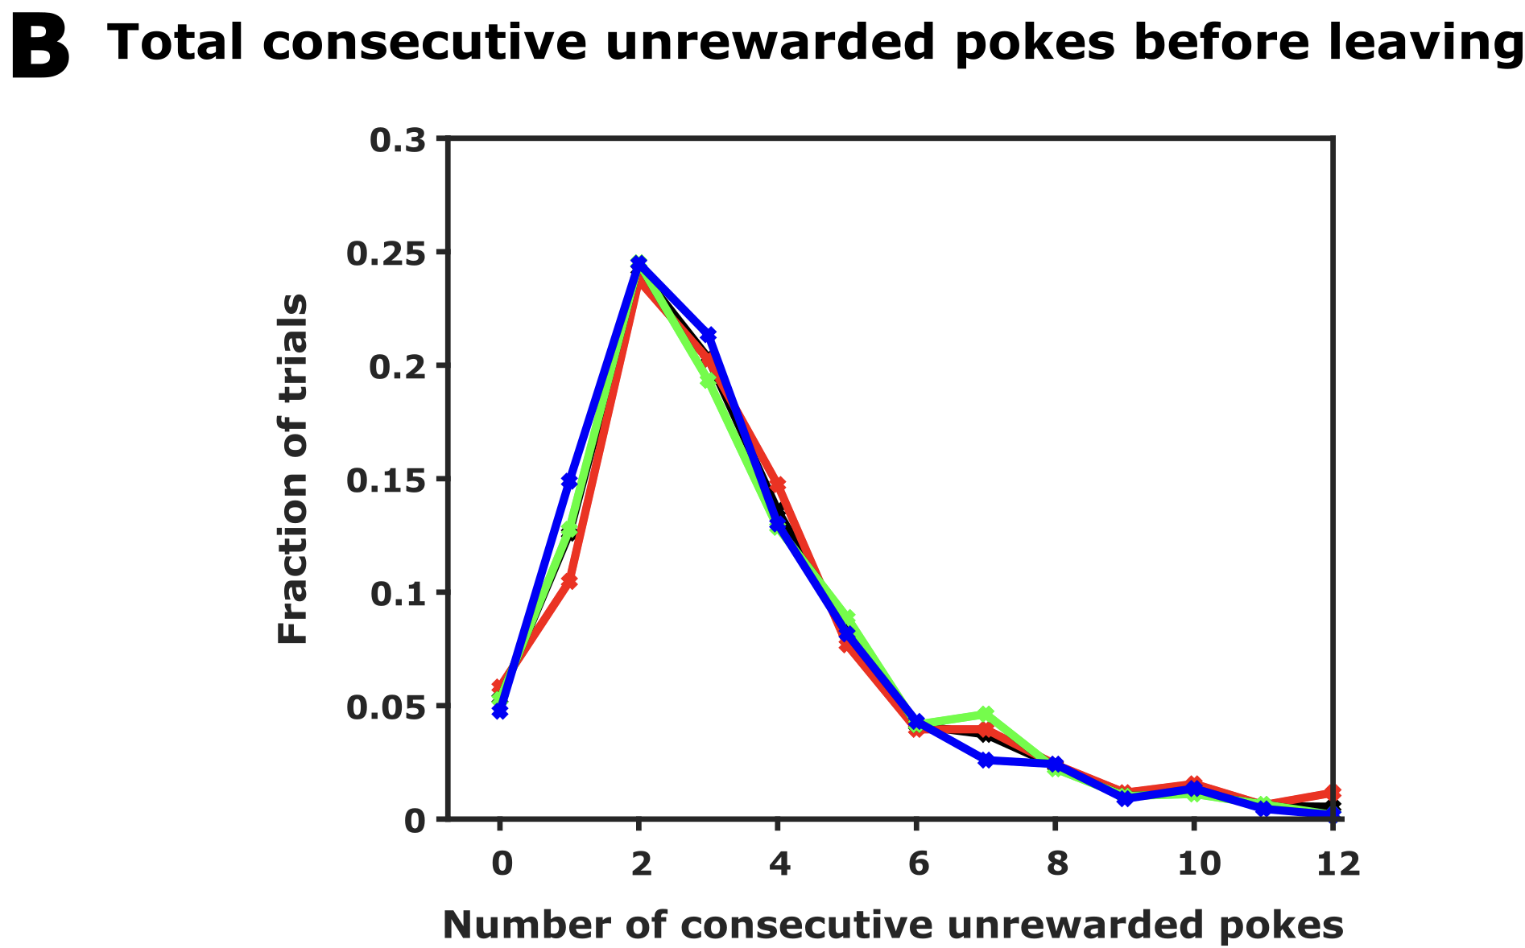
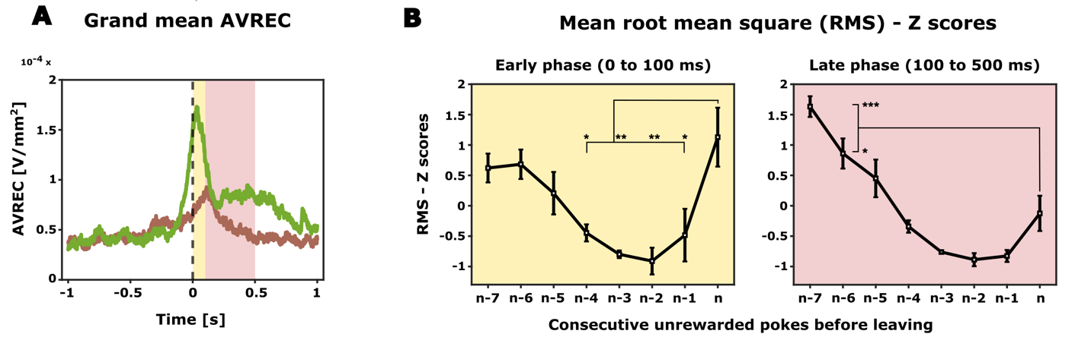
Summary
Behavioural paradigm
Optimal behaviour
Overall frontal activity
Layer-dependent processing
Probabilistic foraging
Animals form inference about hidden probabilities
Increase in overall frontal activity just before the animal decides to explore
Decisive role by altering current expectation and adopting adequate search strategies
Inference-based decision making
Role of frontal cortex in exploration/exploitation dilemma and attentional resource allocation.

Slide 15
Future directions
Spectral analysis
Reinforcement learning based modeling
Optogenetic intervention
Comparative foraging task in humans using high-field fMRI

Slide 16

Future directions
Spectral analysis
Reinforcement learning based modeling
Optogenetic intervention
Comparative foraging task in humans using high-field fMRI
Next stop: PhD
Me
What I want from my PhD?
- Scientific interests
- Open to different/ new ideas
- Collaborative environment
- Interpersonal relationship with PI and peers
Experiment
Computation

Slide 17

Next stop: PhD
Statistical Learning Lab – de Hoz Lab
Me
Experiment
Computation
Dr. Livia de Hoz

Slide 18
Thank you
?
Questions

Slide 19
Research experience
Offline spike sorting
How does altering single-cell and population-level activity affect a monkey’s working memory?
Learning and memory
Spatial audio setup with a software interface
Sensory perception
How does sound localization help in perceiving spatial audio?
How does sensory integration in a Gerbil’s auditory cortex guide an animal’s decision in a changing environment? (Auditory reversal learning)
Linear array of speakers
Cognitive flexibility
Time frequency analysis
Supervised learning – movement intention and movement
Clinical rehabilitation
Potential classification feature to design a brain-computer interface for post-stroke rehabilitation
Adaptive decision making
How do neuronal activity patterns in the frontal cortex shape an animal’s adaptive decision-making behaviour in a foraging task?
Current work (Master thesis)

Slide 20
Future directions
Reinforcement Learning Modeling can help to investigate the trial-by-trial parameters, that underlie animal's inference-bound adaptive decision-making behavior, providing insights into the neural circuitry of attentional resource allocation
Optogenetic intervention to understand the causal relationship
In a comparative foraging task in humans using high-field fMRI, we plan to observe if similar layer-specific functions during exploration/exploitation transitions can be demonstrated.

Slide 21
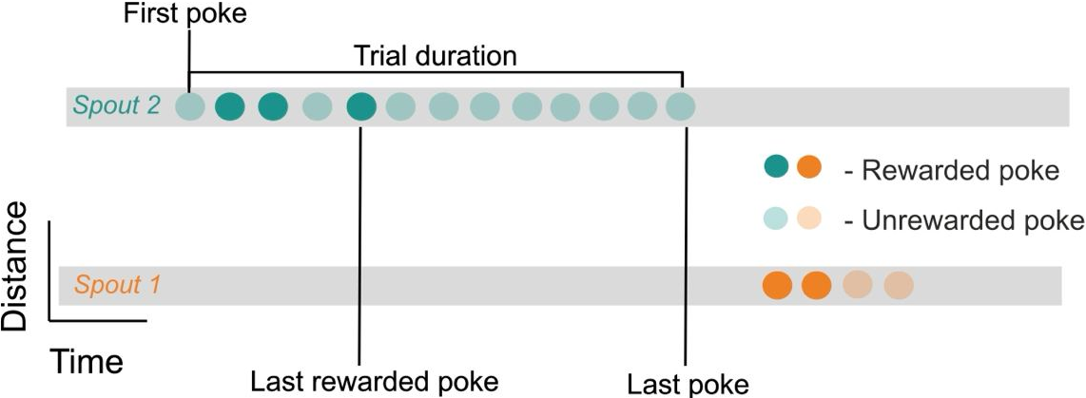
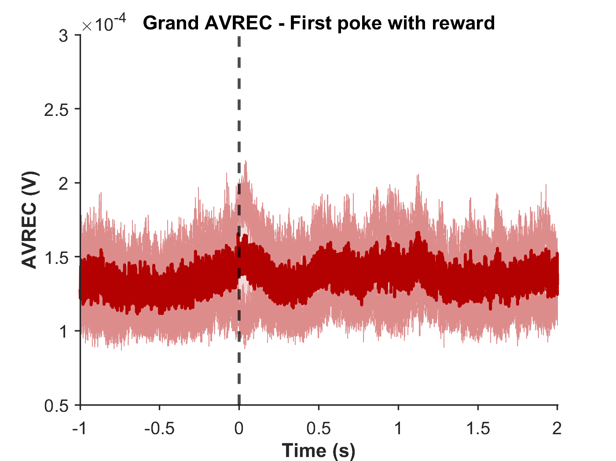
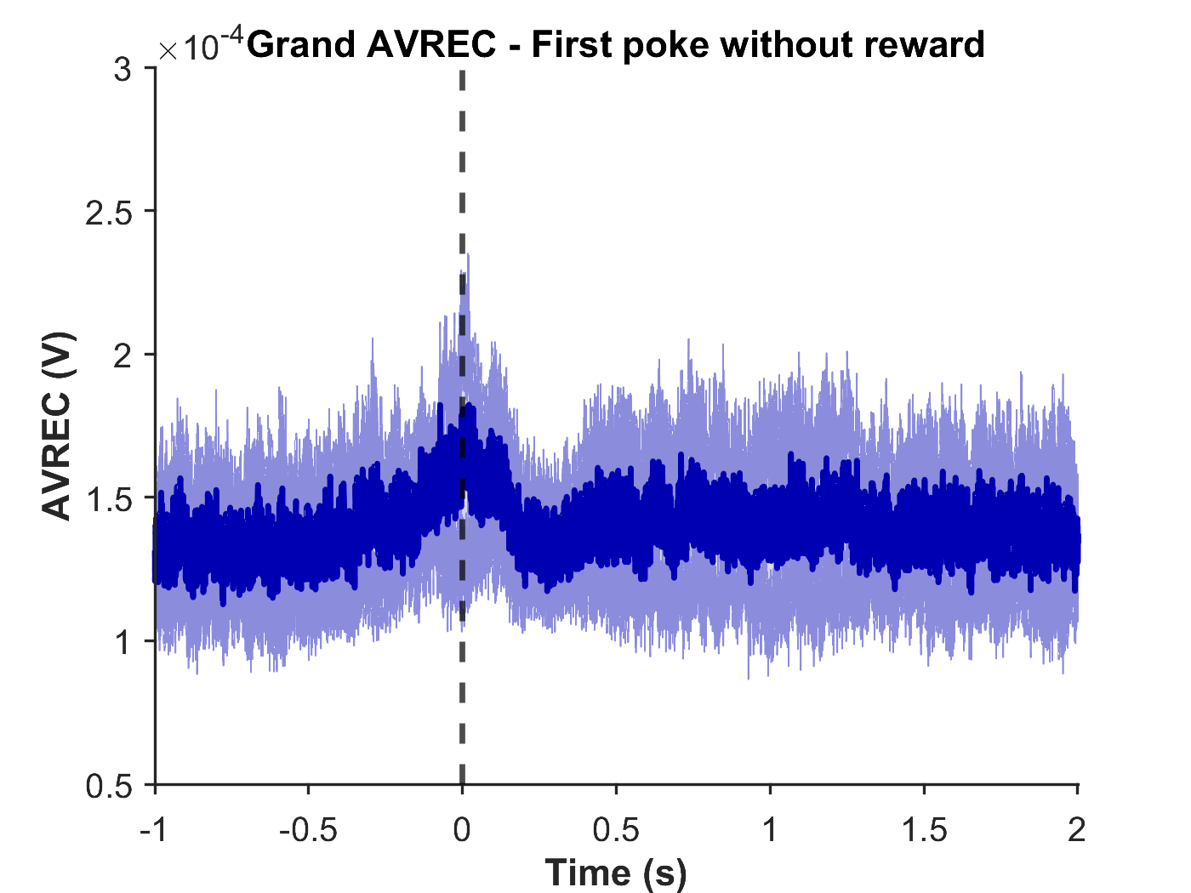
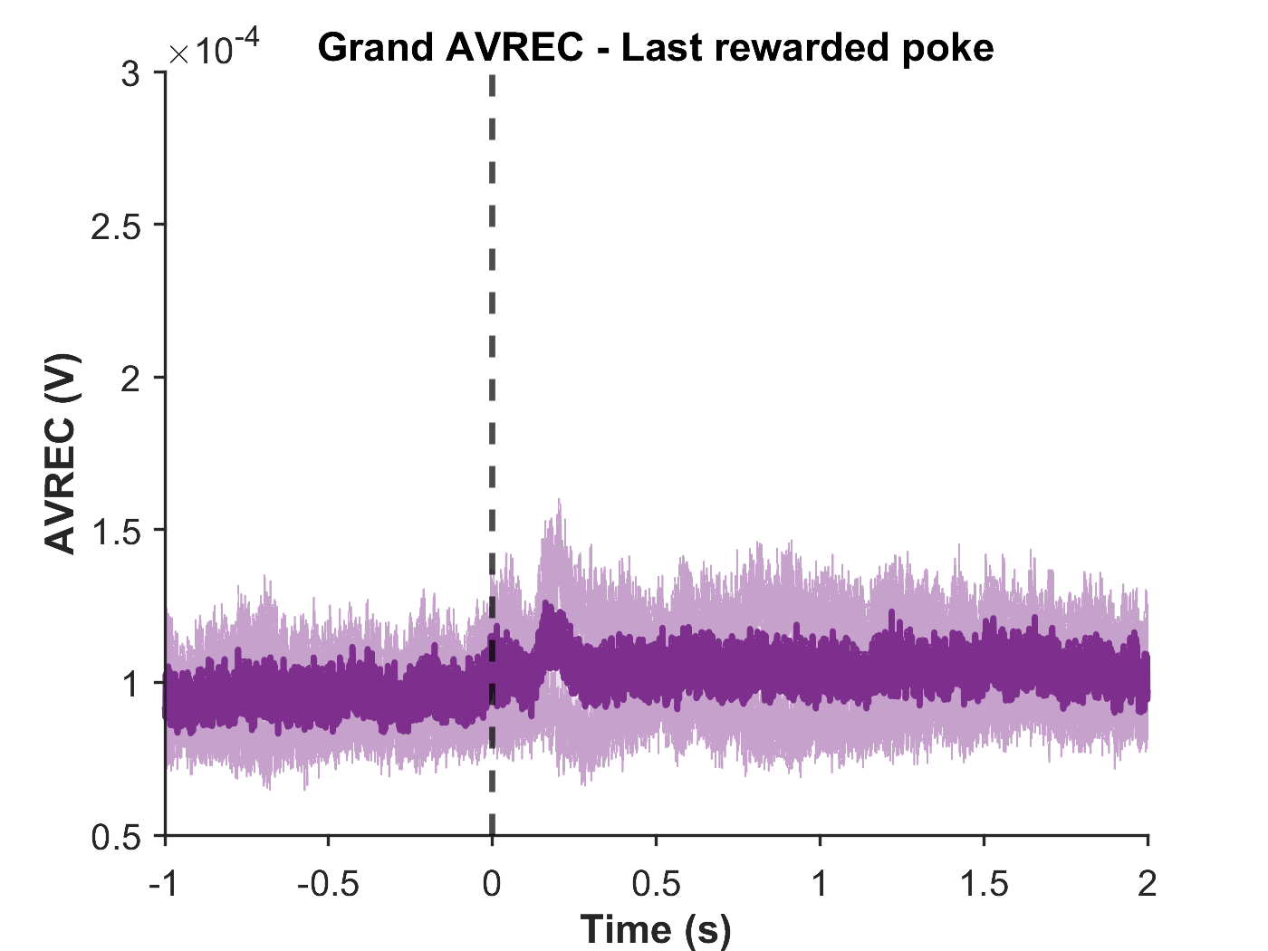
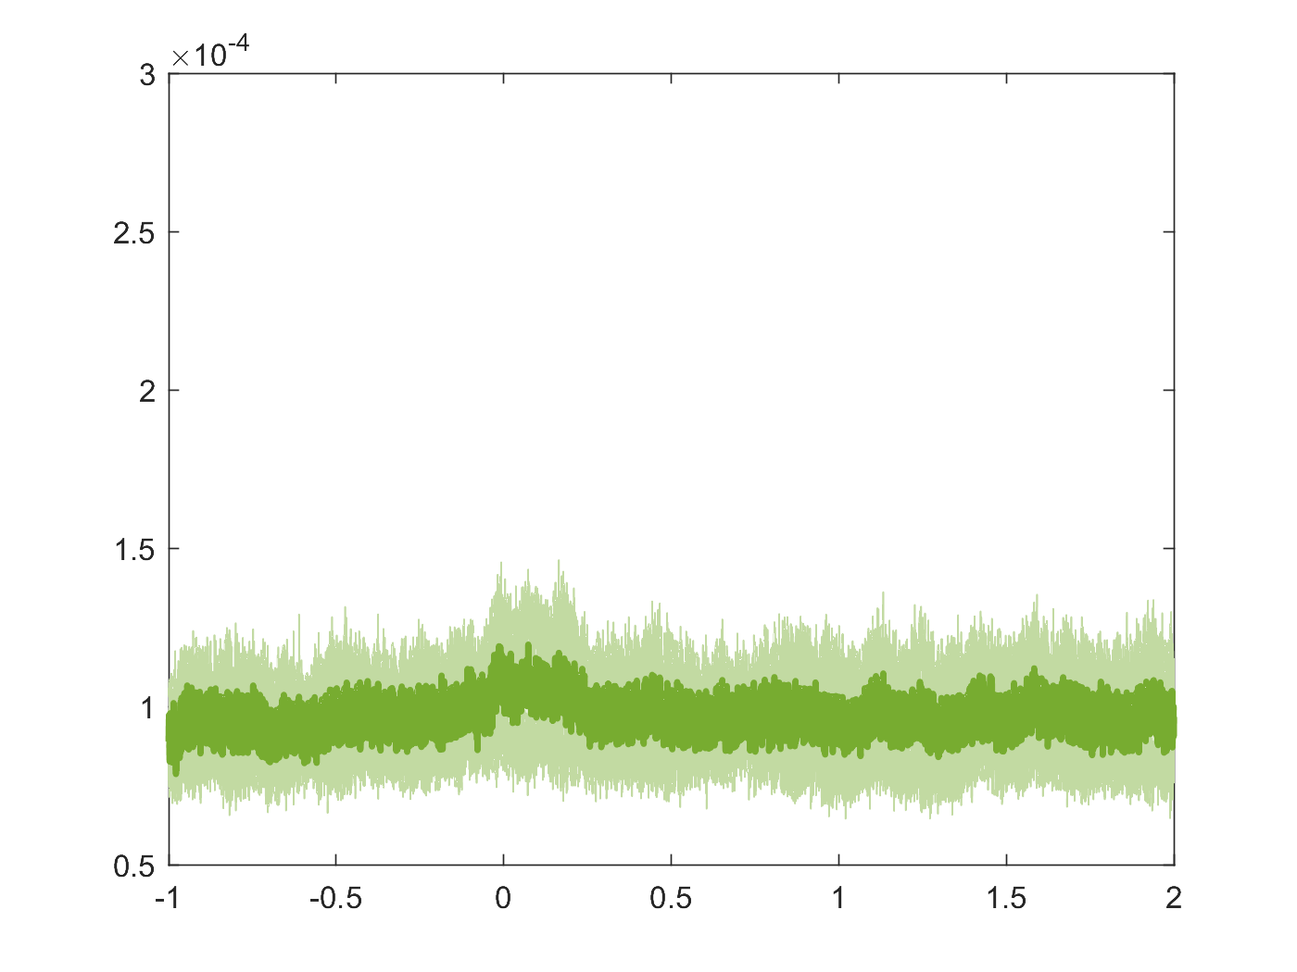
Signal from motor cortex
(4mm from bregma, motor cortex)
(4.65mm from bregma)

Slide 22
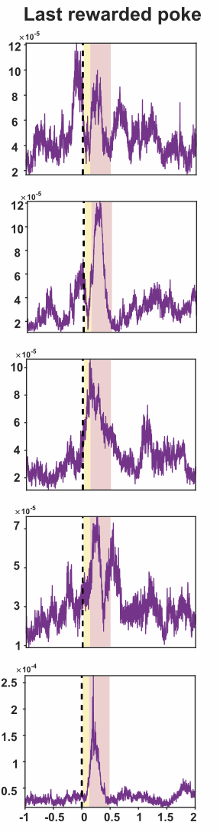
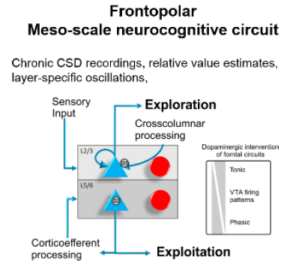
Exploration
Sensory input
Cross columnar processing + long-range inter-cortical connections
L2/3
L5/6
Corticoefferent processing
Exploitation

Slide 23
Next stop - PhD
Me
Experiment
Computation
Animal behaviour and its underlying neural circuits
- adaptive decision making
- sensory/ context perception

